Slide 1
What will you choose?

Slide 2
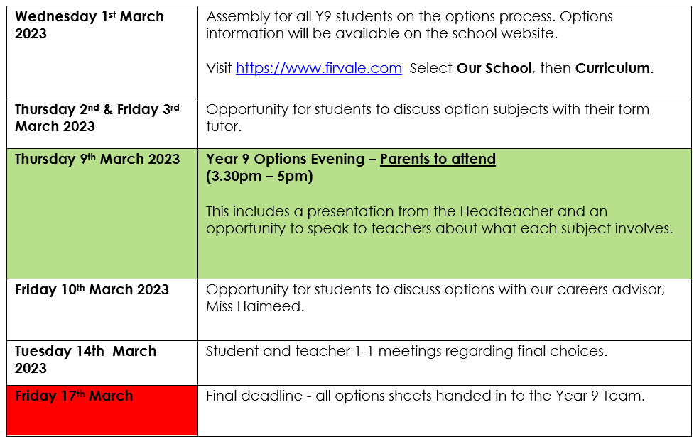
The Process
Today
Next Week
Ends

Slide 3
You need to attend to collect your options booklet

Slide 4
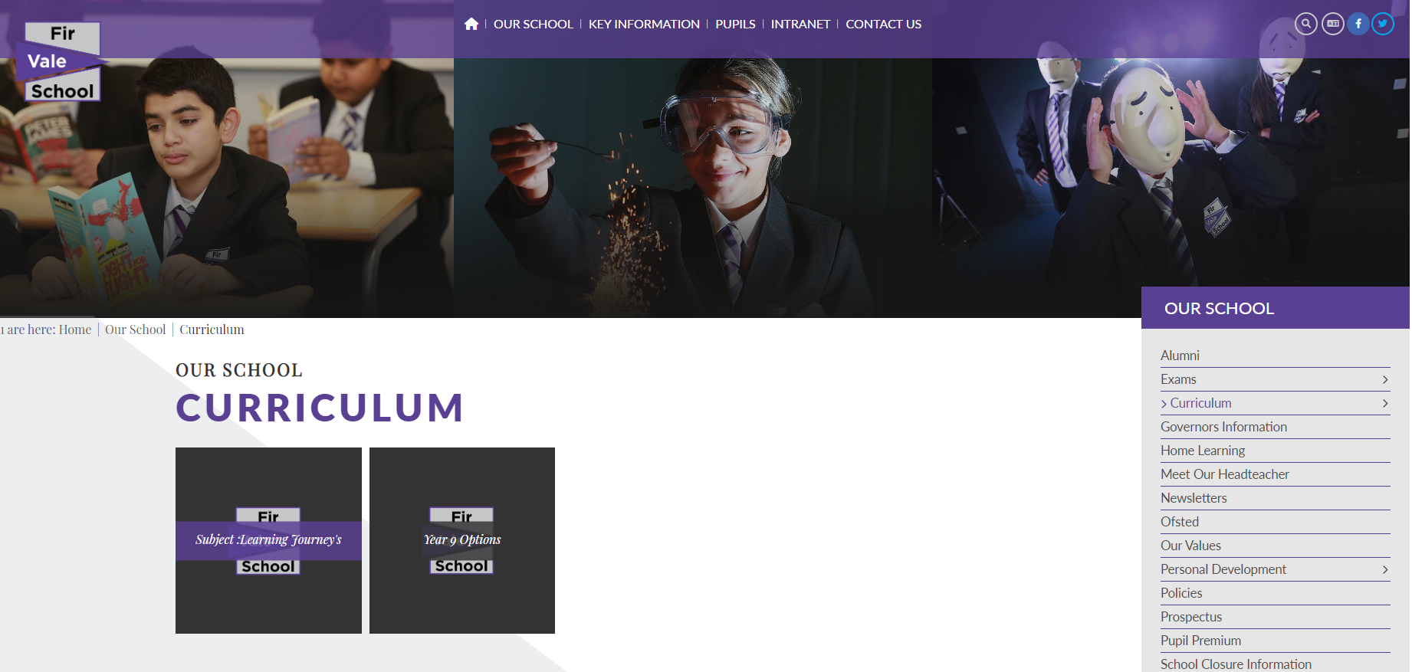
Information – Website and Booklet

Slide 5
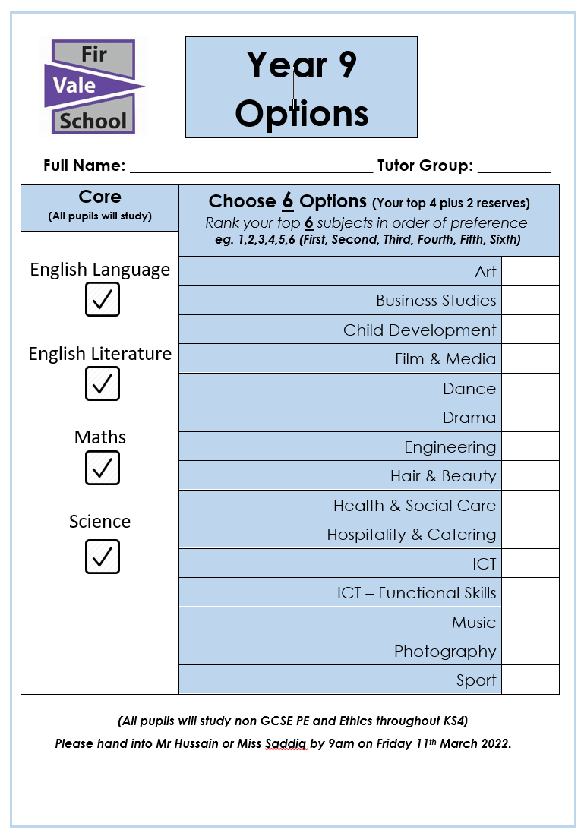

Slide 6
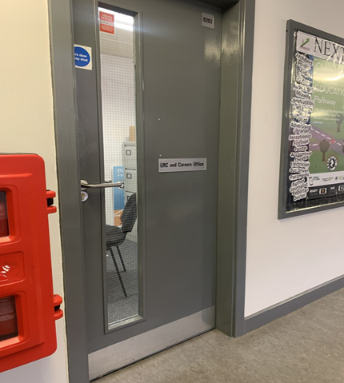
Careers Introduction
1:1 and group work may contain
Support you with understanding where your options can lead too
Support with building up with post 16 providers
Help you to understand the different types of routes out there - Apprenticeship, Traineeships, A levels, BTECS and T LEVELS etc.
Helping you to develop a professional attitude when working with external parties
Supporting you in gaining work experience placements
Year 10 and 11 begin to start application process through Sheffield progress
CV writing, interview preps and careers advice
Where you can find me?
Careers office
Miss Haimeed
Information
Advice
Guidance

Slide 7
Support
Miss Charlton (Deputy Headteacher)
Mr Hussain (Head of Y9)
Miss Siddiq (Deputy Head of Y9)
Miss Haimeed (Careers Advisor)
Tutors
And any other member of staff in school you may wish to speak to

