Slide 1

Student Revision Guide
Y11 Mock Exams
Start = Monday 19th October
Finish = Friday 27th November
Results day = Monday 7th December
Name |  | Tutor Group |  | Candidate Number

Slide 2
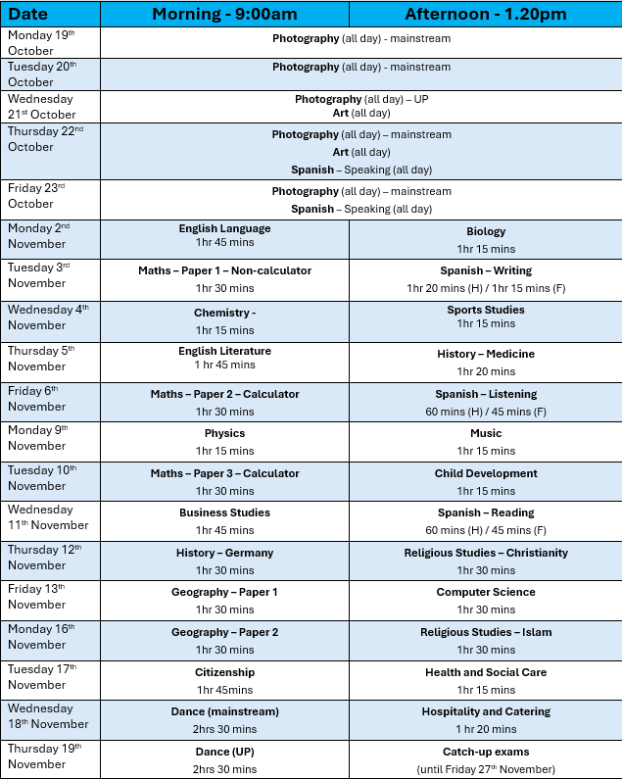

Exam timetable
Y11 Mock Exam Timetable October / November 2026

Slide 3
EXAM RULES
BEFORE YOU ENTER THE EXAM ROOM (Based on JCQ Regulations)
✓ Arrive at least 10 minutes before the start time
✓ Check your seat number on your timetable
✓ NO mobile phones, watches, or smart devices allowed
✓ Only bring: pens, pencils, equipment needed, water in clear bottle (no label)
✓ Pencil cases MUST be see-through
✓ Leave bags, coats, and all other items at the back of the room
EXAM ROOM RULES
From the moment you enter until you are dismissed, you are under formal exam conditions.
You must be silent.
What this means:
NO talking to anyone at any time - not before, during, or after the exam
NO communicating in any way - no gestures, notes, or signals
NO disturbing other candidates
If you break silence, this will be reported and may result in disqualification
DURING THE EXAM
Listen carefully to the invigilator's instructions
Do NOT open your paper until told to start
Write in BLACK INK only (pencils/colours for diagrams only)
Put your hand up if you need help - DO NOT speak
Stay in your seat unless given permission to leave
All work (including rough work) must be done on the exam paper
You cannot leave during the final 15 minutes
AT THE END OF THE EXAM
STOP WRITING immediately when time is called
Stay seated and silent until told to leave
Leave row by row when instructed
Hand in ALL papers before leaving
Exit in SILENCE - show respect for others still working
⚠️ IMPORTANT: These rules apply to ALL exams
Breaking these rules shows a lack of personal responsibility and respect

Slide 4
Exam RULES
SPECIAL RULES FOR ALL-DAY PRACTICAL EXAMS
Art, Photography, and some Computer Science exams run differently - but exam rules STILL apply.
KEY DIFFERENCES FROM STANDARD EXAMS
✓ These exams may last all day
✓ You may need to move around the room
✓ You may work at different stations
✓ You may not have a fixed seat for the entire duration
✓ Supervised breaks are not provided - you manage your own time
⚠️ This is a FORMAL EXAMINATION - the same rules apply as in an exam hall
ABSOLUTE RULES FOR THESE EXAMS
NO TALKING at any time - not about the weather, your work, or anything else
NO COMMUNICATION with other candidates - verbal, written, or gestures
Work independently - your work must be 100% your own
NO helping others or accepting help from others
Computer/internet access is RESTRICTED to exam requirements only
NO unauthorised websites or applications
NO mobile phones or smart devices at any time
Respect the workspace - even without assigned seating
COMPUTER ACCESS RULES
Your computer activity is monitored. You may ONLY:
Access programs/websites specified in the exam brief
Use resources explicitly permitted by the exam instructions
Work on your own examination project
You must NOT:
Access email, messaging, or social media
Search for answers online (unless specifically permitted)
Share files or communicate digitally
Use AI tools or unauthorised assistance
WHY SILENCE MATTERS IN THESE EXAMS
Even though you can move around, talking or communication:
→ Gives unfair advantage to you or others
→ Disrupts concentration
→ Shows lack of personal responsibility and respect
→ Will be treated as malpractice
REMEMBER: Just because the format is different doesn't mean the rules are relaxed.
You are sitting a formal examination.

Slide 5
Exam conduct
WHAT HAPPENS IF YOU BREAK THE RULES?
These consequences apply to BOTH mock exams and real exams.
UNAUTHORISED ITEMS (phones, watches, notes, etc.)
JCQ Rule: Having unauthorised items is malpractice - even if you don't use them
  → Reported to exam board as malpractice
  → Possible disqualification from that exam (zero marks)
  → Possible disqualification from ALL your exams
  → Impact on university applications
TALKING (before, during, or after the exam)
JCQ Rule: Any communication with other candidates is prohibited
  → Reported to exam board
  → Marks may be deducted or exam invalidated
  → Possible disqualification from ALL exams
  → Could prevent you from progressing to sixth form/college
SERIOUS MALPRACTICE (copying, phones in exam, helping others)
JCQ Rule: These actions undermine the integrity of qualifications
  → Removed from exam immediately
  → Reported to exam board (required by law)
  → DISQUALIFICATION from ALL examinations
  → Results withheld or cancelled
  → JCQ may impose a ban on future entries
  → Your entire future could be affected
⚠️ IMPORTANT REMINDER
"I didn't know" or "I wasn't thinking" is NOT an excuse. You are responsible for following the rules.
When you enter an exam room, you accept responsibility for:
Knowing the rules
Following the rules
The consequences of breaking the rules
Your exams are your future. Don't let a moment of poor judgment destroy months of hard work.

Slide 6
Revision Advice
🎯 1. Know what you will be tested on
Get the specification for each subject (from the exam board website).
Know exactly what topics will be examined.
Understand the question formats (multiple choice, long answer, etc.).
📅 2. Create a realistic revision timetable
Use short sessions: 25–30 minutes (Pomodoro technique), followed by 5-minute breaks.
Include all subjects but prioritise weak areas.
Build in rewards and rest days.
🧾 3. Past papers = practice like it’s the real thing
Start early with past papers (available from exam board websites).
Time yourself under exam conditions.
Mark your answers using the official mark schemes.
🔄 4. Mix it up (Interleaving)
Don't study the same subject or topic for hours.
Mix different topics (e.g., revise science equations, then English quotes).
It keeps your brain engaged and improves memory retention.
🧘 5. Don’t neglect wellbeing
Get enough sleep (at least 7–8 hours).
Stay hydrated, eat healthy food.
Avoid consuming too many caffeinated drinks.
Take regular screen breaks
Take part in exercise or other hobbies you enjoy.
✏️ 6. Use revision resources wisely
Online platforms like:
  Seneca Learning, BBC Bitesize. Sparx, Physics and Maths Tutor
YouTube channels (e.g., Mr Bruff for English, Cognito for Science, Khan Academy for maths)
🧍‍♂️ 7. Revise with friends
Teach each other topics.
Quiz each other using flashcards or mini-tests.
📚 8. Prepare fully just before each exam
Get an early night and set an alarm with plenty of time to get to school
Pack your bag with a clear water bottle, a snack and black pens
Know your seat number and candidate number
Go to the toilet before the exam
Put your phone and watch in your bag and leave it at the back of the exam room
Remove all mental and revision notes from your pockets
Arrive early for the exam, show up to the AM booster sessions

Slide 7
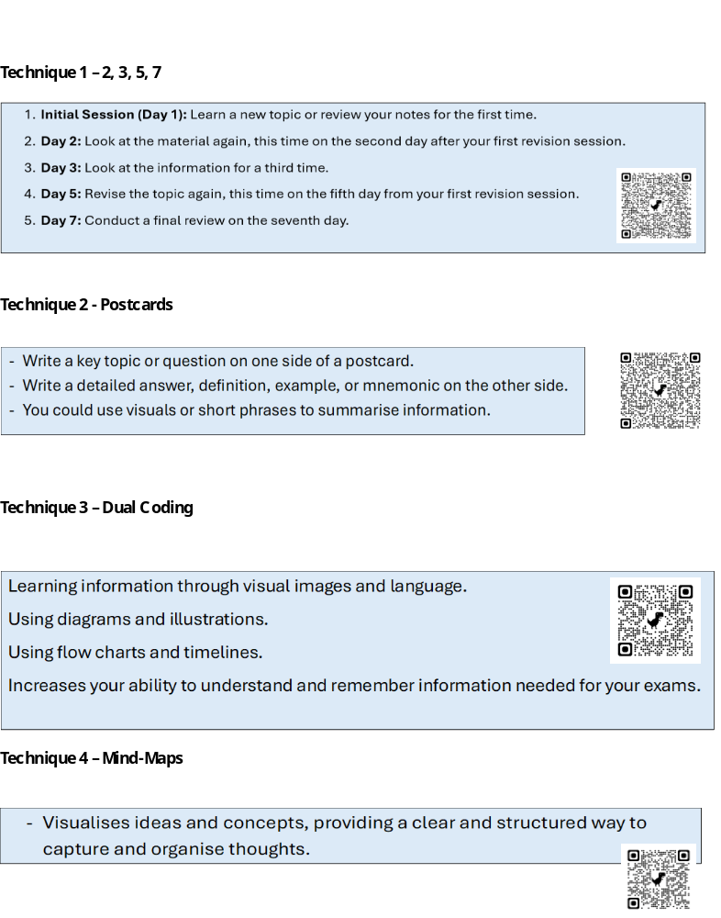
Revision TECHNIQUES

Slide 8
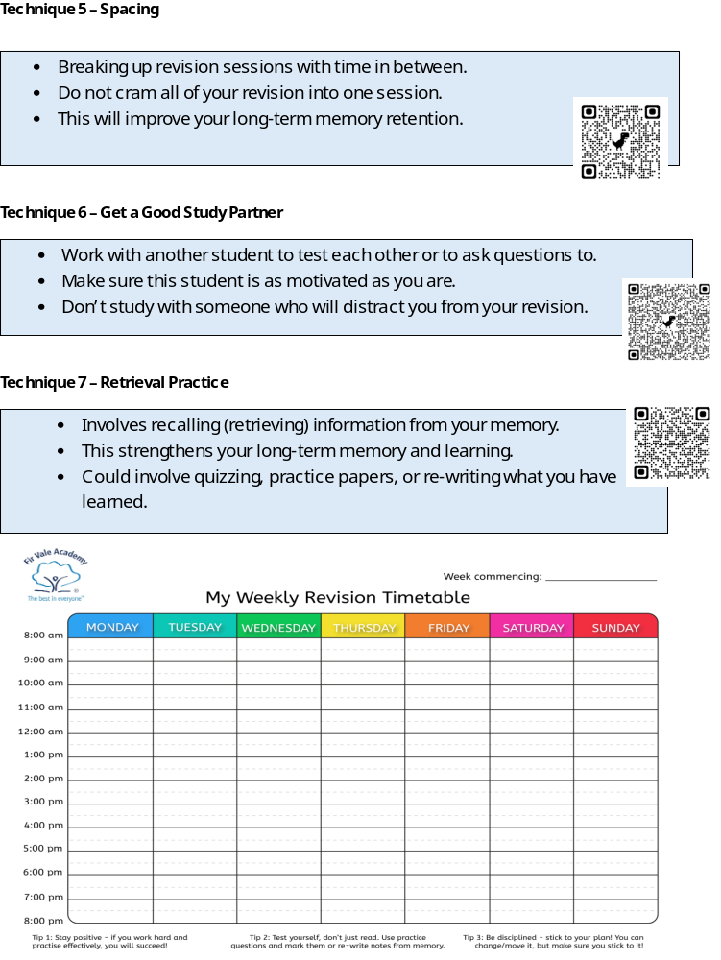
Revision TECHNIQUES

Slide 9

ENGLISH LANGUAGE
Monday 2nd November 9:00am
1hr 45 mins
Paper | Paper 2 | Length | 1 hr 45 min | Marks | 80
Topics / Subjects – what will be on the exam?
2 texts (unseen) – both will be Non-fiction and can be about any topic. One text will be modern and the other will be 19th / 20th Century Question 1 – Reading – Identify 4 TRUE statements from a choice of 8 (4 marks) Question 2 – Reading – Summarise the key difference between the two different texts (8 marks) Question 3 – Reading – Analyse the language used to express the writer’s viewpoint across the whole text (12 marks) Question 4 – Reading – Compare the methods used by both writers to present their different points of view (16 marks) Question 5 – Writing – You will be given a statement and then you have to provide a written response in the form of an article, speech, letter, blog entry. The statement will be linked to the topic of the two texts (40 marks)
Useful tips
Spend 10 minutes reading both texts before you begin answering questions. Have a go at answering every question. Question 1 – Read the statements very carefully. They will be about a very specific part of the text. Spend 5 minutes on this question. Question 2 – Refer to context, use quotes to back up your points, and use PEAL paragraphs to link ideas. Spend 10 minutes on this question. Question 3 – Identify language devices and rhetorical techniques, comment on their impact and write in PETER paragraphs. Spend 15 minutes on this question. Question 4 – Summarise each writer’s viewpoint and then compare and contrast them using PEAL paragraphs. Comment on the historical context in which each text was written. Spend 20 minutes on this question. Question 5 – Provide an opinion and then justify it with the use of rhetorical language. Follow the rules and the style of the text type you are being asked to write in. Spend 45 minutes on this question.
Useful Revision Resources
https://www.bbc.co.uk/bitesize/examspecs/zcbchv4
Lead Teacher | Mr Yarsley | Email | Myarsley@firvale.com
Specification | https://www.aqa.org.uk/subjects/english/gcse/english-8700/specification
Notes:
Draft guide for the full AQA Combined Science: Trilogy (8464) Physics Paper 1 syllabus. School to confirm whether its mock tests the full Paper 1 content. AQA official specification: https://www.aqa.org.uk/subjects/science/gcse/science-8464/specification. AQA official assessment structure: https://www.aqa.org.uk/subjects/science/gcse/science-8464/specification/specification-at-a-glance . Past papers: https://www.aqa.org.uk/pastpapers.

Slide 10
ENGLISH LITERATURE
Thursday 5th November 9:00am
1hr 45 mins
Paper | Paper 2 | Length | 2 hr 15 min | Marks | 100
Topics / Subjects – what will be on the exam?
Section A = Modern Prose or Drama – An Inspector Calls (34 marks) Answer ONE question about An Inspector Calls. You will have a choice of 2 questions – you only need to answer 1. Section B = Poetry Anthology – Power and Conflict (34 marks) You will have a poem from the anthology printed on the paper. This could be any of the ones you have studied in lesson. You have to answer one question about the poem, which involves you comparing it with another poem from the anthology of your choice. Section C = Unseen poetry (32 marks) Part 1 = Answer one question about a poem you have never seen before (24 marks) Part 2 = Answer one question about another poem you have never seen before, but comparing it to the poem in part 1 (8 marks)
Useful tips
Plan every answer before you start writing your answer. Section A = Modern Prose or Drama – An Inspector Calls (45 minutes) Begin your essay by introducing the wide themes of An Inspector Calls and then linking it to the question. It could be a question about character or theme. Choose the one that you feel the most confident about. Make sure you use evidence – this could be quote or a reference to a moment in the play. Include reference to context. Section B = Poetry Anthology – Power and Conflict (45 minutes) Start with a short introduction using words from the question. Use PEAL paragraphs. Comment on the language, poetic techniques, tone and form of both poems. Make sure you write about two poems, including the one printed on the paper. Section C = Unseen poetry (45 minutes) Read the poems carefully at least 3 times. Write about the language and structure of each poem. Use the question to help you to understand what the central message of each poem is.
Useful Revision Resources
https://www.bbc.co.uk/bitesize/examspecs/zxqncwx
Lead Teacher | Mr Yarsley | Email | Myarsley@firvale.com
Specification | https://www.aqa.org.uk/subjects/english/gcse/english-8702/specification
Notes:
Draft guide for the full AQA Combined Science: Trilogy (8464) Physics Paper 1 syllabus. School to confirm whether its mock tests the full Paper 1 content. AQA official specification: https://www.aqa.org.uk/subjects/science/gcse/science-8464/specification. AQA official assessment structure: https://www.aqa.org.uk/subjects/science/gcse/science-8464/specification/specification-at-a-glance . Past papers: https://www.aqa.org.uk/pastpapers.

Slide 11
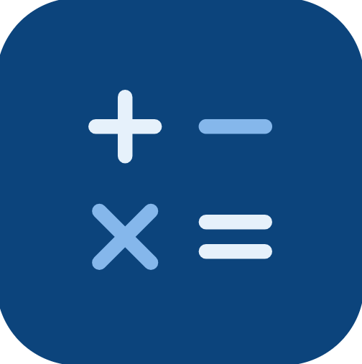
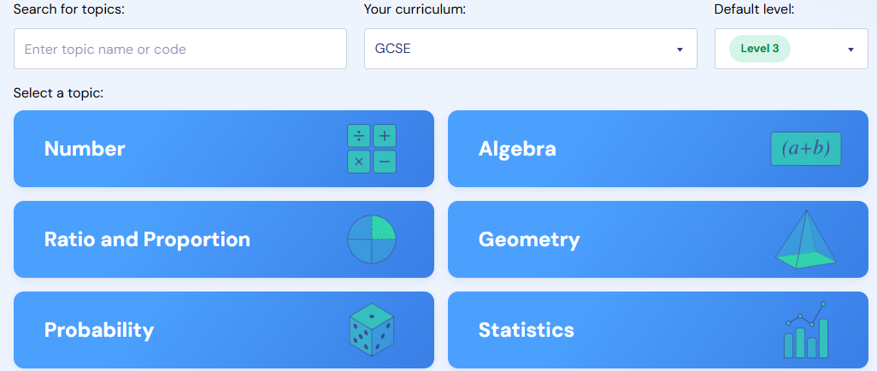
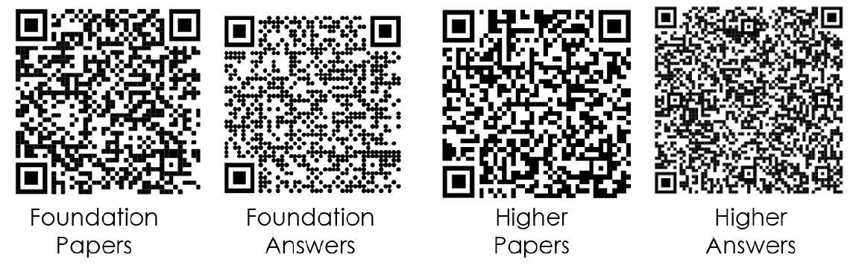
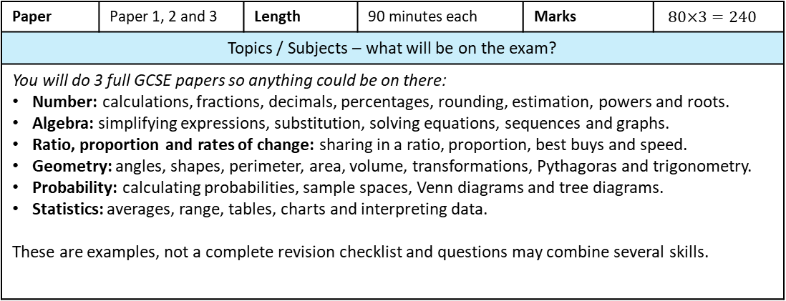
Maths
Paper 2 -
Friday 6th November 9:00am - 1hr 30 mins
Paper 3 -
Tuesday 10th November 9:00am - 1hr 30 mins
Paper 1 -
Tuesday 3rd November 9:00am - 1hr 30 mins
Paper | Paper 1, 2 and 3 | Length | 90 minutes each | Marks | $80×3=240$
Topics / Subjects – what will be on the exam?
You will do 3 full GCSE papers so anything could be on there: Number: calculations, fractions, decimals, percentages, rounding, estimation, powers and roots. Algebra: simplifying expressions, substitution, solving equations, sequences and graphs. Ratio, proportion and rates of change: sharing in a ratio, proportion, best buys and speed. Geometry: angles, shapes, perimeter, area, volume, transformations, Pythagoras and trigonometry. Probability: calculating probabilities, sample spaces, Venn diagrams and tree diagrams. Statistics: averages, range, tables, charts and interpreting data. These are examples, not a complete revision checklist and questions may combine several skills.
Useful tips
Revise by doing maths. Practise questions regularly, rather than just reading notes or watching videos. Show your working. Write down each step, including when you use a calculator. Read carefully. Identify what the question asks you to find. Check units and any rounding instructions. Keep going. When stuck, write a useful first step, move on and return to the question later. Check your answers. Look for calculation errors and ask yourself whether the answer is sensible.
Useful Revision Resources
Useful Revision Resources
Sparx Maths: Use Independent Learning to practise topics you find difficult. Search by topic name or use a topic code from your teacher. Use the support videos when needed, then attempt questions independently. Practice Papers from Mr Malik in the LRC Collect practice papers for your tier. Check your answers, correct mistakes and bring questions you cannot do to your maths teacher. Use both together: attempt a practice paper → identify a topic to improve → practise it on Sparx → try the exam question again.
Lead Teacher | Mr Kelly | Email | mkelly@firvale.com
Specification | Pearson Edexcel GCSE (9–1) Mathematics (1MA1)

Slide 12

BIOLOGY
Monday 2nd November 1:20pm
1hr 15 mins
Paper | Paper 1 (F/H) | Length | 1 hr 15 min | Marks | 70
Topics / Subjects – what will be on the exam?
B1 Cell biology: cell structures; microscopy and magnification; mitosis; diffusion, osmosis and active transport. B2 Organisation: enzymes and digestion; food tests; heart and blood vessels; plant transport. B3 Infection and response: pathogens and diseases; body defences; vaccination, antibiotics and drug testing. B4 Bioenergetics: photosynthesis and limiting factors; aerobic and anaerobic respiration. Required practicals 1–5: microscopy; osmosis; food tests; amylase and pH; photosynthesis and light intensity. Types of questions: Choose or recall an answer: for example, identify a cell structure or name a pathogen. Apply knowledge: explain what happens to a cell in a particular solution. Use data: read a table or graph, spot a pattern and draw a conclusion. Calculate: for example, magnification, percentage change or a rate. Explain a practical: describe a method, identify variables or suggest an improvement. Write a longer answer: explain a process such as photosynthesis or evaluate evidence in a new context.
Useful tips
1. Start with B1–B4. After each short revision session, answer questions on that topic. 2. Mark your answers. Add any missing science words to a short correction list. 3. Learn the five practical methods: what changes, what stays the same and what is measured. 4. Practise magnification, percentage change, graph reading and rates. 5. For longer answers, use the question’s key words and make each point clear. Example: Describe how you could investigate the effect of light intensity on the rate of photosynthesis in pondweed. Include how you would obtain valid results. [6 marks] Model answer: Place pondweed in water containing sodium hydrogencarbonate, which provides carbon dioxide. Put a lamp a measured distance from the pondweed. Measure the volume of oxygen produced in five minutes. Repeat this at several lamp distances, using the same time each time. Keep the temperature and carbon dioxide concentration the same so that only the light intensity changes. Repeat each distance and calculate a mean, then compare the mean rates of oxygen production. Why this works: it says what to change, what to measure, what to keep the same and how to make the results more reliable. Those are the details students should look for when the question says “describe a method”. The pondweed investigation is a Biology Paper 1 required practical.
Useful Revision Resources
Sparx Science: Independent Learning. Search for B1–B4. AQA past papers: choose Combined Science: Trilogy (8464), Paper 1, your tier. AQA mark schemes: check the exact science words needed for each mark. Class topic tests and corrections: retry questions you missed.
Lead Teacher | Mr Watt | Email | jwatt@firvale.com
Specification | AQA Trilogy (8464) specification
Notes:
Draft guide for the full AQA Combined Science: Trilogy (8464) Biology Paper 1 syllabus. School to confirm whether its mock tests the full Paper 1 content. AQA official specification: https://www.aqa.org.uk/subjects/science/gcse/science-8464/specification. AQA official assessment structure: https://www.aqa.org.uk/subjects/science/gcse/science-8464/specification/specification-at-a-glance . Past papers: https://www.aqa.org.uk/pastpapers.

Slide 13

CHEMISTRY
Wednesday 4th November 9:00am
1hr 15 mins
Paper | Paper 1 (F/H) | Length | 1 hr 15 min | Marks | 70
Topics / Subjects – what will be on the exam?
C1 Atomic structure and the periodic table: atoms and isotopes; electron arrangements; Groups 0, 1 and 7. C2 Bonding and properties: ionic, covalent and metallic bonding; structures and their properties. C3 Quantitative chemistry: balancing equations; conservation of mass; relative formula mass; concentration; moles (Higher). C4 Chemical changes: reactivity and extraction; acids and salts; electrolysis. C5 Energy changes: exothermic and endothermic reactions; reaction profiles. Required practicals 8–10: making a soluble salt; electrolysis; temperature change in reactions. Types of questions: Recall or identify: name a type of bonding, particle or product of a reaction. Explain: link a substance’s structure and bonding to its properties, or explain what happens during electrolysis. Write equations: complete word equations or balance symbol equations. Calculate: relative formula mass, percentage by mass or concentration. Higher tier also includes moles. www.aqa.org.uk Use data: interpret a graph, table or reaction profile. Describe a practical: explain how to make a soluble salt, investigate electrolysis or measure a temperature change.
Useful tips
1. Learn the ions and reaction patterns, then write word and balanced symbol equations. 2. Practise Ar, Mr, percentage by mass and concentration. Higher: include moles. 3. For electrolysis, identify the electrolyte, each electrode and the products. 4. Revise each practical’s method, variables, observations and safety steps. 5. Check your units and show each step in calculations. Example: Describe how to prepare a pure, dry sample of copper sulfate crystals using copper oxide and dilute sulfuric acid. [6 marks] Model answer: Warm the dilute sulfuric acid gently in a beaker. Add copper oxide a little at a time and stir until some black solid remains. This shows that all the acid has reacted. Filter the mixture to remove the excess copper oxide. Gently heat the copper sulfate solution until crystals start to form, then leave it to cool. Filter out the crystals and dry them between pieces of filter paper. Why this works: the answer follows the method in order and explains why excess copper oxide is added and then filtered off. Making a pure, dry soluble salt is a Chemistry Paper 1 required practical
Useful Revision Resources
Sparx Science: Independent Learning. Search for C1–C5. AQA past papers: choose Combined Science: Trilogy (8464), Paper 1, your tier. AQA mark schemes: check the exact science words needed for each mark. Class topic tests and corrections: retry questions you missed.
Lead Teacher | Mr Watt | Email | jwatt@firvale.com
Specification | AQA Trilogy (8464) specification
Notes:
Draft guide for the full AQA Combined Science: Trilogy (8464) Chemistry Paper 1 syllabus. School to confirm whether its mock tests the full Paper 1 content. AQA official specification: https://www.aqa.org.uk/subjects/science/gcse/science-8464/specification. AQA official assessment structure: https://www.aqa.org.uk/subjects/science/gcse/science-8464/specification/specification-at-a-glance . Past papers: https://www.aqa.org.uk/pastpapers.

Slide 14

PHYSICS
Monday 9th November 9:00am
1hr 15 mins
Paper | Paper 1 (F/H) | Length | 1 hr 15 min | Marks | 70
Topics / Subjects – what will be on the exam?
P1 Energy: stores and transfers; work done, power and efficiency; energy resources. P2 Electricity: current, potential difference and resistance; series/parallel circuits; power and the National Grid. P3 Particle model: density; changes of state; specific heat capacity and latent heat. P4 Atomic structure: atomic model; alpha, beta and gamma radiation; half-life; contamination and irradiation. Required practicals 14–17: specific heat capacity; resistance of circuits; I–V characteristics; density. Types of questions: Recall or identify: name an energy store, recognise a circuit symbol or give a unit. Explain: describe an energy transfer, explain how a circuit works or compare types of radiation. Calculate: use equations for energy, electrical power, resistance or density. Students should show their working and include units. Use data: interpret a graph, table, circuit diagram or radioactive decay data. Describe a practical: explain how to measure density, investigate resistance, measure I–V characteristics or determine specific heat capacity.
Useful tips
1. Use the AQA equation sheet. Choose the equation and identify each quantity first. 2. Convert units before calculating. Write the answer with its unit. 3. Practise circuit diagrams, energy calculations, density and half-life graphs. 4. Know the four practical methods (listed above), especially measurements, graphs and controls. 5. Compare alpha, beta and gamma using penetration and ionising power. Example: Describe how you would find the density of a small, irregularly shaped solid that sinks in water. [6 marks] Model answer: First, zero a balance and measure the mass of the solid in grams. Put water in a measuring cylinder and record its starting volume in cm³. Lower the solid into the water until it is completely submerged, then record the new volume. Subtract the starting volume from the new volume to find the volume of the solid. Divide its mass by its volume to calculate its density in g/cm³. Repeat the measurements and calculate a mean density. Why this works: it identifies both measurements, explains how to find the volume of an irregular object, gives the calculation and includes units. Density is a Physics Paper 1 required practical.
Useful Revision Resources
Sparx Science: Independent Learning. Search for P1–P4. AQA past papers: choose Combined Science: Trilogy (8464), Paper 1, your tier. AQA mark schemes: check the exact science words needed for each mark. Class topic tests and corrections: retry questions you missed. AQA Physics equation sheet: practise using it with past papers.
Lead Teacher | Mr Watt | Email | jwatt@firvale.com
Specification | AQA Trilogy (8464) specification
Notes:
Draft guide for the full AQA Combined Science: Trilogy (8464) Physics Paper 1 syllabus. School to confirm whether its mock tests the full Paper 1 content. AQA official specification: https://www.aqa.org.uk/subjects/science/gcse/science-8464/specification. AQA official assessment structure: https://www.aqa.org.uk/subjects/science/gcse/science-8464/specification/specification-at-a-glance . Past papers: https://www.aqa.org.uk/pastpapers.

Slide 15

ART
Thursday 22nd October -
All day
Wednesday 21st October -
All day
Paper | Component 1 | Length | 10 hours | Marks | 18
Topics / Subjects – what will be on the exam?
You will create a final piece (A04) for your Natural Form Unit You have already been planning your final piece in lessons You will have 2 days (5 hours each day) to create your final piece You need to use ALL of the 10 hours You will have normal breaks/lunches No music is allowed and you must work silently and independently There will be a seating plan You can ask the teacher for resources etc or if there is a problem. However, the teacher cannot give you advice or help Your work must be your own
Useful tips
Use all of the time available – keep working and improving it until it is the absolute best piece of work If you do finish you can do a 2nd piece It needs to link to your theme and your artists It should be personal and match your sketchbook Use your planning work from your sketchbook Make sure you have taken ideas from the artists you have studied Draw lightly and rub out Don’t rush This should be your best piece of work and use what you are best at – the teacher should have told you what material/medium you excel in – use this as the recommended medium If it looks bad – finish it – then start again
Useful Revision Resources
Make sure your planning sheet is complete Bring in any resources you might want – you can buy/bring your own materials The teacher will supply you with what you have asked for / or can supply some things on the day Make sure any printing is done BEFORE the exam – if you need an image to trace, print it first - otherwise you might have to project and draw it
Lead Teacher | Mrs Clement | Email | eclement@firvale.com
Specification | https://qualifications.pearson.com/en/qualifications/edexcel-gcses/art-and-design-2016.html

Slide 16

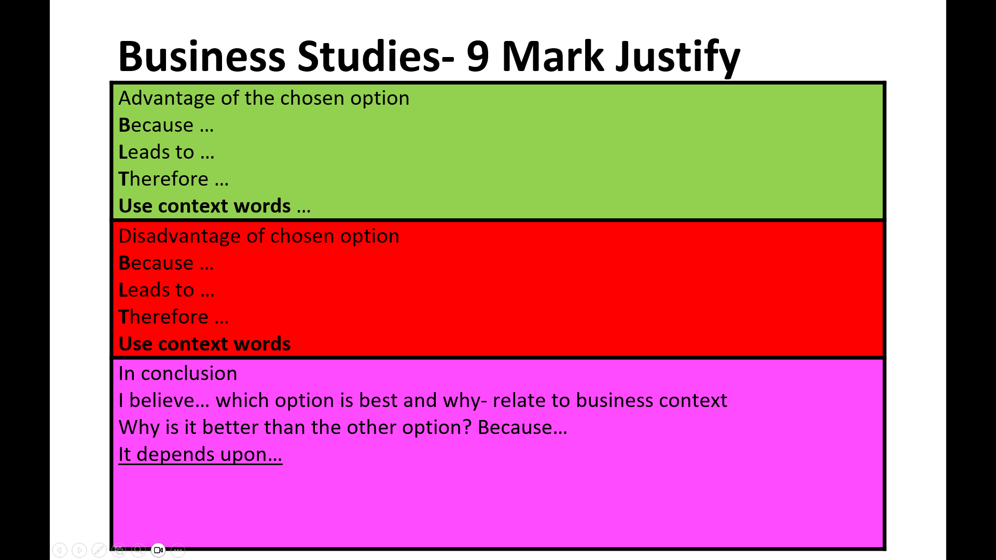
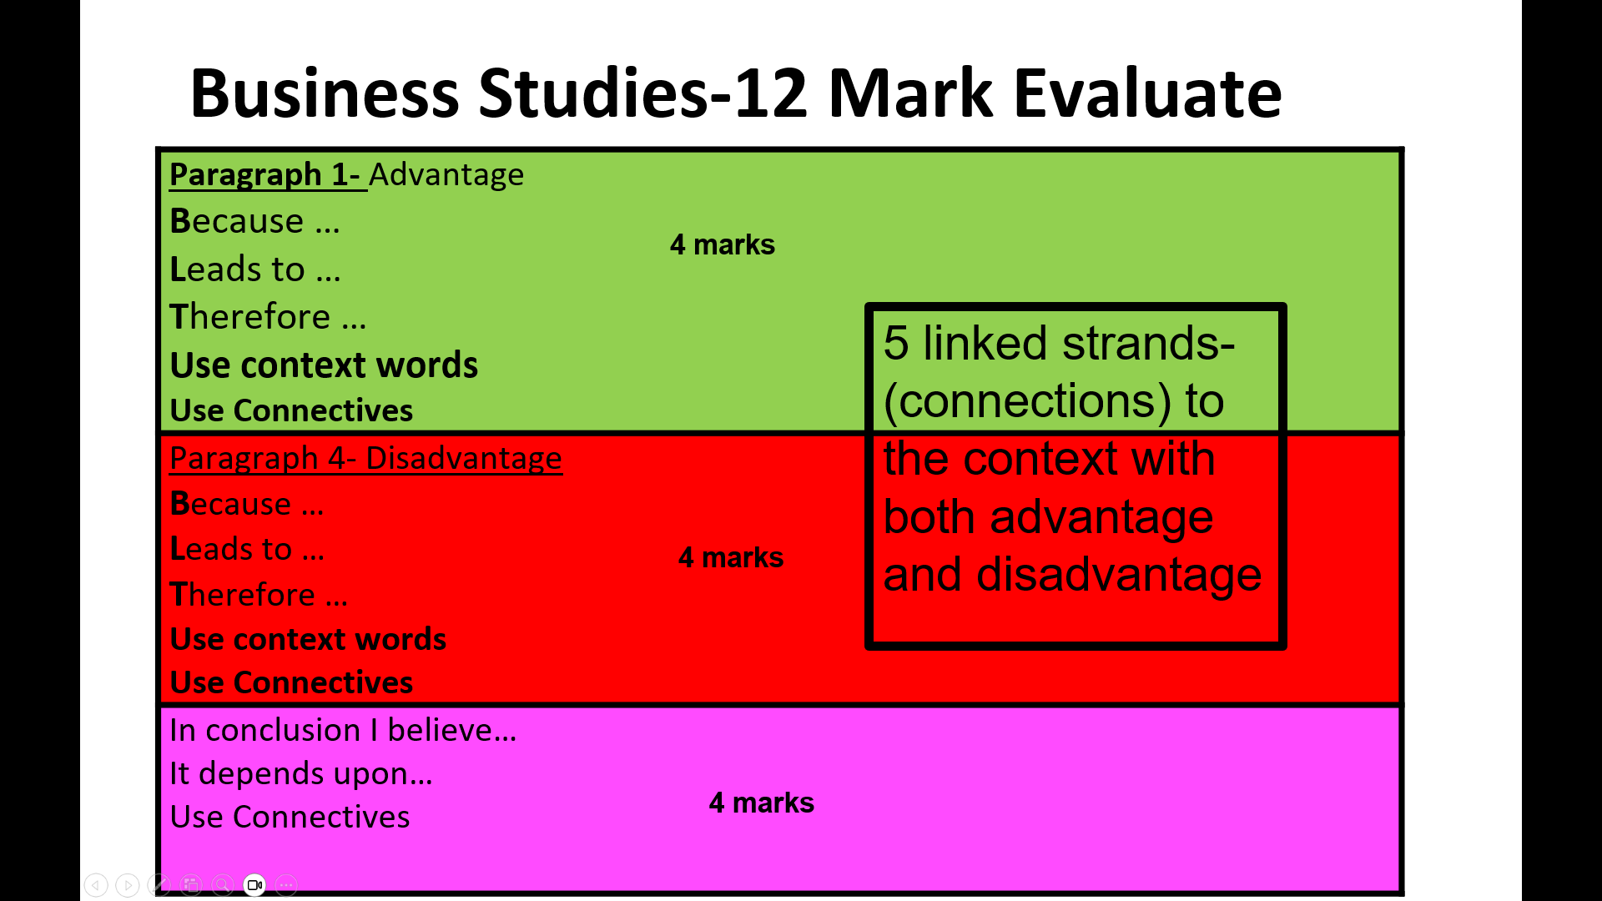
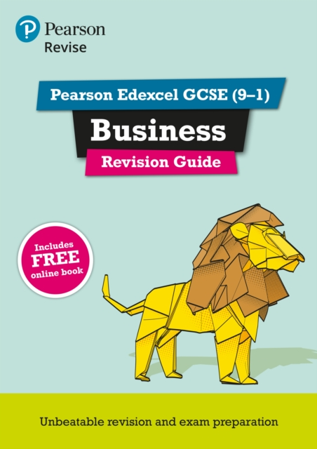

Business
Wednesday 11th November -
9:00am
1hr 45 mins
Paper | Paper 2 | Length | 1 hour 45 mins | Marks | 90
Topics / Subjects – what will be on the exam?
2.1 Growing the Business Methods of growth (internal and external) Mergers and takeovers Globalisation and business growth Public Limited companies-Benefits and drawbacks Share capital and loan capital 2.2 Making Marketing Decisions Design Mix-Function, Aesthetics and Cost Product life cycle and extension strategies- Product trials Building a marketing mix (4Ps)- market segments 2.3 Making Operational decisions Production methods- Job, batch and flow Managing stock (interpret bar gate stock graphs) Just in time- benefits and drawbacks Supplier process, procurement and logistics Sales Process-Customer service 2.4 Making Financial decision Business calculations-Gross and net profit Calculate total profit Calculate Average rate of return on investment Business performance- financial data graphs and charts 2.5 Making human resource decisions Ways of working-flexible working Fulltime, part time, permanent contacts and remote working Recruitment and selection-CV, application form, job description and person specification Training and development-formal and informal Motivation-financial and non financial rewards, retaining employees and job enrichment
Useful Revision Resources
https://www.bbc.co.uk/bitesize/examspecs/z98snbk https://www.tutor2u.net/business/gcse https://revisionworld.com/gcse-revision/business-studies https://www.businessed.co.uk (117) EDEXCEL GCSE Business Exam Technique - YouTube Revision guides given to all students
Lead Teacher | Mrs Asgar | Email | sasgar@firvale.com
Specification | https://qualifications.pearson.com/en/qualifications/edexcel-gcses/business-2017.html

Slide 17

Child development
Tuesday 10th November -
1:20pm
1hr 15 mins
Paper | R057/01 | Length | 1 hour 15 minutes | Marks | 70
Topics / Subjects – what will be on the exam?
June 2026 R057 content to revise: • Antenatal care – first appointment (8–12 weeks), routine checks/tests, GP, obstetrician and midwife. • Labour & birth – signs labour has started; hospital birth advantages/disadvantages; birth-partner support; first stage of labour; episiotomy; pethidine. • Pregnancy screening – anomaly scan and amniocentesis. • Reproduction & contraception – identical twins; menstrual cycle; male/female reproductive organs; contraceptive implant. • Postnatal care – newborn hip check; health visitor; physical/emotional support for new parents; routines and baby developmental needs. • Pre-conception health – effects of weight and smoking on women AND men. • Child health & safety – bathroom hazards/prevention; safety labels; tonsillitis signs/care; reducing SIDS risk.
Useful tips
• Learn precise key terms — vague answers can lose marks. • IDENTIFY/STATE = short fact; DESCRIBE = detail; EXPLAIN = point + why/how; DISCUSS = several developed points. • Give exactly the number of answers requested and make each answer different. • For 2–3 mark explanations, develop the point rather than simply listing facts. • 8-mark discussion: cover BOTH physical and emotional support, develop several points and use appropriate terminology. • 6-mark question: cover BOTH weight and smoking and apply effects to BOTH women and men. • Read the scenario carefully and apply your answer to the people in the question.
Useful Revision Resources
R057 class notes, knowledge organisers and retrieval quizzes. June 2026 R057 question paper — practise under timed conditions. June 2026 R057 mark scheme — check the precise terminology OCR credits. OCR Cambridge National Child Development specification (J809) — use the clickable link below. Flashcards: health professionals, antenatal tests, labour/birth, screening, contraception, pre-conception health, illness/safety and SIDS. Practise the June 2026 extended responses: 8-mark family/friends support and 6-mark pre-conception weight/smoking.
Lead Teacher | Miss Emptage | Email | cemptage@firvale.com
Specification | OCR Cambridge National Child Development J809 – Specification

Slide 18

CITIZENSHIP
Tuesday 17th November -
9:00am
1hr 45 mins
Paper | 2 | Length | 1 hour 45 mins | Marks | 80
Topics / Subjects – what will be on the exam?
Life in Modern Britain How can citizens make their voice heard and make a difference in society? What is the UK's role in key international organisations? What is the role of the media and the free press? What do we mean by identity? What are the principles and values that underpin British society? Rights and Responsibilities How do citizens play a part to bring about change in the legal system? What are the universal human rights and how do we protect them? How has the law developed over time, and how does the law protect the citizen and deal with criminals? What are a citizen's rights and responsibilities within the legal system? What laws does a society require and why?
Useful tips
Learn British values, identity and diversity with clear examples.
Revise how media influences opinions and democracy.
Know the UK’s global roles (UN, NATO, Commonwealth).
Practise reading and explaining data (graphs, tables, trends).
Learn key rights: Human Rights Act, Equality Act, children’s rights.
Understand the justice system: courts, roles, criminal vs civil law.
Know how citizens protect rights (pressure groups, legal action).
Use PEE chains for 8‑mark answers with balanced conclusions.
Useful Revision Resources
Free GCSE Citizenship Studies AQA Revision Content — Study Rocket YouTube Primrose Kitten Academy | GCSE & A-Level Revision – search for citizenship paper 2 Seneca AQA GCSE Citizenship Studies (8100) Revision Notes, Past Papers, Quiz & Exam Questions | SimpleStudy UK
Lead Teacher | Mrs Cocking | Email | Jcocking@firvale.com
Specification | GCSE Citizenship Studies 8100 | Specification | AQA

Slide 19

Computer Science
Friday 13th November
1:20pm
1hr 30 mins
Paper | 2 | Length | 1 hour 30 minutes | Marks | 80
Topics / Subjects – what will be on the exam?
Writing algorithms – pseudocode Writing algorithms – Flowcharts Boolean Logic Computational Thinking Structured Query Language – Searching and storing data Program Flow – Reading flowcharts Arrays Searching algorithms Sorting algorithms
Useful tips
Focus on refining your skills with each topic. If you are strong on one topic, prioritise practicing weaker topics to bring those skills up.
Useful Revision Resources
OCR Revision Guides OCR Knowledge Organisers Craig’n’Dave YouTube channel for OCR Component 2 videos: 2.1 - Algorithms: https://www.youtube.com/playlist?list=PLCiOXwirraUAzsy9tacd98LBTbj7cyFQV 2.2 – Programming fundamentals: https://www.youtube.com/playlist?list=PLCiOXwirraUAujkBVyzSh-LjjTCDwMU8v 2.3 – Producing robust programs: https://www.youtube.com/playlist?list=PLCiOXwirraUBb_Y1hsCHRgbvq0wXFVnj2 2.4 – Boolean logic: https://www.youtube.com/playlist?list=PLCiOXwirraUCY53WmW5wqNgM4P-vms0Kl 2.5 – Programming languages and IDEs: https://www.youtube.com/playlist?list=PLCiOXwirraUACqOhOXpdnjG5S6qZpurTO
jslocombe@firvale.com
Lead Teacher |  | Email
Specification | https://www.ocr.org.uk/qualifications/gcse/computer-science-j277-from-2020/
Mr J Slocombe

Slide 20

BTEC PERFORMING ARTS - DANCE
Wednesday 18th November -
9:00am
2hrs 30mins
Assessment | Component 2 – Task 2 | Length | Practical performance | Marks | 36
Topics / Subjects – what will be on the exam?
Professional repertoire: “And You Don’t Even Know It” from Everybody’s Talking About Jamie. Physical skills: posture, alignment, balance, coordination, control, flexibility, strength, stamina and movement accuracy. Expressive skills: characterisation, facial expression, focus, projection, dynamics, energy, timing and musicality. Mental skills: movement memory, concentration, confidence, commitment and responding to corrections. Performance focus: stay in character, perform with clear intention and match the style, timing and dynamics of the professional repertoire.
Useful tips
Know the choreography securely. Strong movement memory frees you to focus on performance quality. Show the character. Use facial expression, focus, projection and clear intention throughout. Dance to the music. Keep accurate timing and show musicality by responding to accents, rhythm and phrasing. Perform, don’t just mark. Use full energy, dynamics, extension and commitment. Maintain technique. Keep control, alignment, coordination and accuracy even when the choreography becomes difficult. Recover quickly. If a mistake happens, stay in character and rejoin confidently.
Useful Revision Resources
Rehearsal video and music: practise the repertoire regularly. Record yourself: check character, timing, musicality, accuracy and energy. Peer/teacher feedback: identify one physical and one expressive skill to improve each rehearsal. Targeted practice: repeat difficult sections slowly, then rebuild to performance speed. Pearson specification: review the Component 2 performance skills and assessment expectations.
Lead Teacher | Miss Emptage | Email | cemptage@firvale.com
Specification | Pearson BTEC Tech Award Performing Arts (2022) – specification

Slide 21

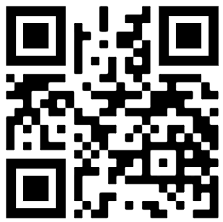
Geography – paper 1
Friday 13th November -
9:00am
1hr 30 mins
Paper | Paper 1 – Living world | Length | 1hr 30 mins | Marks | 88
Topics / Subjects – what will be on the exam?
Tectonic hazards – Causes, effects, responses, Haiti and Japan case studies, management Weather hazards – Causes, effects, responses, Typhoon Haiyan case study, management Climate change – Natural and human causes, impacts, responses (adaptation and mitigation) Ecosystems – nutrient cycle, UK ecosystem (Slapton Ley Reed Bed), global biomes Cold environments – Adaptations of plants and animals, cold environment challenges, cold environment opportunities, management of cold environments Rainforests – adaptations of plants and animals, deforestation in the Amazon, impacts, managing deforestation Coasts – processes (erosion, weathering, deposition), landforms of deposition and erosion, coastal management (hard and soft engineering)
Useful tips
Exam structure is really important. All longer questions will use the KUU format, so the homework booklets will help you practice this. Remember to BUG the question, command words tell you what you need to be doing! You only need to know TWO examples of an opportunity and TWO examples of a challenge for any case study. Only revise TWO animal and TWO plant adaptations for each biome (rainforests and cold environments) All papers will involve some sort of skills question (completing a graph, interpreting a graph, calculating the mean or median), make sure you answer these and practice them
Useful Revision Resources
Your green revision guide contains everything you need to know to succeed in this exam. KUU homework booklets, extras from different topics available from G01 Skills questions booklets are available from G01 Flashcards with key terms for the whole course
Lead Teacher | Mr Smith (WSM) | Email | wsmith@firvale.com
Specification | https://www.aqa.org.uk/subjects/geography/gcse/geography-8035/specification

Slide 22
Geography – paper 2
Monday 16th November -
9:00am
1hr 30 mins
Paper | Paper 2 – Challenges in the human environment and geographical applications | Length | 1hr 30 mins | Marks | 88
Topics / Subjects – what will be on the exam?
Urbanisation – causes and impacts Lagos – challenges and opportunities of urbanisation UK cities – importance of Sheffield Urban regeneration in the UK – Heart of the City II Uneven development – how countries differ from others in levels of development Development measures – limitations Fieldwork – physical fieldwork (Hornsea), how it could be improved, what went well, data presentation, sampling
Useful tips
Exam structure is really important. All longer questions will use the KUU format, so the homework booklets will help you practice this. Remember to BUG the question, command words tell you what you need to be doing! You only need to know TWO examples of an opportunity and TWO examples of a challenge for any case study. All papers will involve some sort of skills question (completing a graph, interpreting a graph, calculating the mean or median), make sure you answer these and practice them
Useful Revision Resources
Your green revision guide contains everything you need to know to succeed in this exam. KUU homework booklets, extras from different topics available from G01 A3 fieldwork summary sheets available from G01 Skills questions booklets are available from G01 Flashcards with key terms for the whole course
Lead Teacher | Mr Smith (WSM) | Email | wsmith@firvale.com
Specification | https://www.aqa.org.uk/subjects/geography/gcse/geography-8035/specification

Slide 23

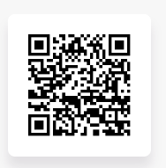
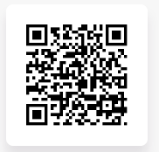
Medicine -
Thursday 5th November
1:20pm – 1hr 20 mins
Germany -
Thursday 12th November
9:00am – 1hr 30 mins
history
Paper | 1 = Medicine = 1 hour 20 minutes = 52 marks 3 = Germany = 1 hour 30 minutes = 52 marks
Topics / Subjects – what will be on the exam?
Medicine in Britain, c.1250-present AND The British Sector of the Western Front, 1914-18: injuries, treatment and the trenches Section A: Special Study: The British Sector of the Western Front, 1914-18: injuries, treatment and the trenches. Exam Questions: Section A [16 marks] Q1a&b = Describe one feature of…[4] Q2a) = Enquiry questions – how useful…[8] Q2b] Following up sources [4] Section B:Medicine in Medieval, Renaissance, 18th & 19th century and Modern Britain. Exam Questions: Section B [36 marks] Q3 = similarity or difference [4] Q4 = Explain why…[12] Q5 OR 6 = How far do you agree? [16+4 spg] Weimar and Nazi Germany, 1918-39 Exam Questions: Section A [16 marks] Q1 = Give two things you can infer from Source A about….[4] Q2a or 2b = Explain why…[12 marks] Exam Questions: Section B [36 marks] – this is the ENQUIRY QUESTION Q3a = How useful are Sources B & C for an enquiry into..? [8] Q3b = What is the amin difference between the views? [4] Q3c = Suggest one reason why interpretations 1 & 2 give different views about…[4] Q3d = How far do you agree with interpretation 2 about…?[16+4spg]
Total time – 1 hour 20 minutes
5 minutes – Read and analyse sources
Section A = 25 minutes
Section B = 50 minutes
Total time – 1 hour 30 minutes
10 minutes – Read and analyse sources
Section A = 26 minutes
Section B = 54 minutes
Useful tips
Highlight the skill, focus of the question and time period eg Explain why there was little change in Medieval medicine 1250-1500. Look at the marks – this will help you know how much time to spend on the question. It’s about a minute and half per mark. Use the bullet points in the question to help you get your minimum marks – tell as much of the story as you can if you are stuck with the technique. Look at past papers in the library - be an expert at what the whole paper looks like What is a source? What is an interpretation? Learn the advantages and disadvantages of both
Useful Revision Resources
BBC bitesize – EDEXCEL EXAM BOARD - Medicine Through Time & Weimar and Nazi Germany topics Seneca – Edexcel topics Germany Medicine
Lead Teacher | Ms Smith | Email | ksmith@firvale.com
Specification | https://qualifications.pearson.com/content/dam/pdf/GCSE/History/2016/specification-and-sample-assessments/gcse-9-1-history-specification.pdf Option 11- Medicine in Britain & Option 31 – Weimar and Nazi Germany, 1918-39

Slide 24

music
Monday 9th November
1:20pm
1hr 15mins
Paper | Component 3: Appraising | Length | 1 hour 15 minutes | Marks | 80
Topics / Subjects – what should I revise?
The mock will be a Eduqas GCSE Music Appraising examination. You should revise; All four Areas of Study: Musical Forms and Devices; Music for Ensemble; Film Music; Popular Music. Set works: Bach, Badinerie and Toto, Africa — know key facts and be able to describe the musical elements. Musical Forms and Devices: binary, ternary, rondo, variation, repetition/contrast, sequences, cadences, ornaments, Baroque/Classical/Romantic features. Music for Ensemble: chamber music, jazz/blues, musical theatre, texture, sonority, roles of instruments/voices. Film Music: mood/atmosphere, leitmotif, ostinato, drone, pedal, sequence, dynamics, texture, instrumentation, technology/sound effects. Popular Music: riffs, hooks, verse/chorus structure, 12-bar blues, walking bass, syncopation, blue notes, technology/production features. Core listening skills: melody, rhythm, metre, tempo, harmony, tonality, texture, dynamics, articulation, instrumentation and structure. Practice notation/listening questions: reading treble and bass clef, rhythms, intervals, chords, cadences and short dictation tasks.
Useful tips
Use the musical elements in every answer: melody, rhythm, harmony/tonality, texture, tempo, dynamics, sonority/instrumentation and structure. For compare questions, write one clear similarity and one clear difference, using musical vocabulary. When you hear an extract, note the obvious first: instruments, tempo, mood, metre, texture and any repeated ideas. For set works, revise the key features rather than trying to memorise paragraphs. Make flashcards for key terms, listen actively to extracts, and practise identifying instruments, textures, cadences and structures.
Useful Revision Resources
Elemental – use the revision resources and activities set by your Music teacher. This is designed to assist with your revision for the exam specifically and should be used regularly to help you consolidate and check your knowledge. If you are unsure what to revise on Elemental, or need help finding the right materials, speak to your Music teacher. Knowledge organisers can also be provided by your music teacher. You will need to be able to listen to the set work - Bach 'Badinerie' and Toto 'Africa'.
Lead Teacher | Music Department | Email | eswift@firvale.com
Specification | https://www.eduqas.co.uk/qualifications/music-gcse/#tab_keydocuments

Slide 25

PHOTOGRApHY
Mon 19th Oct / Tues 20th Oct / Thurs 22nd Oct / Fri 23rd Oct – all day
Weds 21st Oct – UP – all day
Paper | PHOTOGRAPHY | Length | 10 hours | Marks | 59
Topics / Subjects – what will be on the exam?
The Photography exam is a test to see if you can use the creative editing that you have practiced in class without help. Your teacher can help with equipment and printing but they cannot give you any advice once the exam has started. You can have access to the same equipment and computer tools as in class but you can not use the internet for anything else. By the time you get to the exam you should already have practiced your outcomes in class.
Useful tips
Have a clear plan! By the time you get to the exam day you should already know what you want your outcomes to look like. Take your time, exams are marked for quality and care not amount Record all of your attempts, starting again shows care and attention and improves your grade.
Lead Teacher | Mr Grifflow | Email | jgrifflow@firvale.com
Specification | Pearson Edexcel GCSE in Art and Design specification

Slide 26

Religious
studies
Christianity
Thursday 12th November
1:20pm - 1hr 30mins
Islam
Monday 16th November
1:20pm - 1hr 30mins
Paper | Islam | Length |  | 90 minutes | Marks | 78
Topics / Subjects – what will be on the exam?
Muslims Beliefs Living the Muslim Life Matters of Life and Death
Paper | Christianity | Length | 90 minutes | Marks | 78
Topics / Subjects – what will be on the exam?
Christian Beliefs Living the Christian Life Philosophy of Religion
Useful tips
How can you get the MOST marks in YOUR exam? Think about the BEST strategy for you:
AQ: 3 marks: Which is the better option for you?
BQ: 4 marks: Which is the better option for you?
CQ: 5 marks: Which is the better option for you?
DQ: Which is the better option for you?
Point Point Point | Point Point Evidence
Point + Explain // Point + Explain | Point + Explain // Point + Quote
Point + Explain + Quote // Point + Explain | Point + Quote + Infer // Point + Explain
Point + Quote + Infer // Point + Explain (Agree) Point + Quote + Infer // Point + Explain (Disagree) Conclusion = Point + Explain | Include a STRENGTH after each reason Include a CRITICISM after each reason Compare the 2 reasons in the PQI//PE
Useful Revision Resources
In the revision guide you were given last year, the topics can be found on the following pages: Muslim Beliefs = Pages 68 - 75 Living the Muslim Life = Pages 84 - 91 Matters of Life and Death = Pages 92 - 99 Christian Beliefs = Pages 1 - 8 Living the Christian Life = Pages 19 - 26 Philosophy of Religion = Pages 51 - 59 Miss Lowry will provide separate materials with useful quotes/evidence to help you with all the different topics.
Lead Teacher | Miss Lowry | Email | clowry@firvale.com
Specification | https://qualifications.pearson.com/en/qualifications/edexcel-gcses/religious-studies-b-2016

Slide 27

Thursday 22nd October
Friday 23rd October
All day
Spanish - Speaking
Paper | Speaking | Length | 20 minutes | Marks | 50
Topics / Subjects – what will be on the exam?
Topic 1 – Lifestyle and wellbeing: sport, free time, healthy lifestyle and wellbeing. Topic 2 – Media and Technology: TV programmes, films and technology. Topic 3 – My personal world: family, friends, free time and personal plans. Topic 4 – Studying and the future: school and future plans. Topic 5 – Travel and tourism: Holidays
Useful tips
Practice the key phrases for the photo description (PALMW) – you need to include a lot of detail, like the hair style and colour, what people are wearing, as many things as you can name from the background… Make sure that you learn all the answers for your chosen topic from the speaking booklet. You must be able to answer confidently. Write your notes during the exam preparation time clearly, so you don’t struggle finding your answers or answer the wrong question by mistake.
Useful Revision Resources
Speaking booklet Sample photo description and role play cards.
Lead Teacher | Mr Salgado | Email | fsalgado@firvale.com
Specification | https://qualifications.pearson.com/en/qualifications/edexcel-gcses/spanish-2024.html?gclsrc=aw.ds&gad_source=1&gad_campaignid=24264331379&gbraid=0AAAAAodf4cU0wF7xCC2-UXShxRFetW2Q4&gclid=EAIaIQobChMIiOmZhf6BlwMVEpNQBh3lHjtsEAAYASAAEgI4QvD_BwE

Slide 28
Spanish - LISTENING
Friday 6th November
1:20pm
60 mins (H) / 45 mins (F)
Paper | Listening | Length | 45/60 minutes | Marks | 50
Topics / Subjects – what will be on the exam?
Topic 1 – Lifestyle and wellbeing: sport, free time, healthy lifestyle and wellbeing. Topic 2 – Media and Technology: TV programmes, films and technology. Topic 3 – My personal world: family, friends, free time and personal plans. Topic 4 – Studying and the future: school and future plans. Topic 5 – Travel and tourism: Holidays
Useful tips
Revise vocabulary: knowing what words mean is the most important part, and the only way to succeed. Complete tasks at home to make sure you train your ear to recognise the vocabulary you learn. Make sure you understand what each question is asking you to do so you don’t miss easy marks.
Useful Revision Resources
Seneca learning Languagenut
Lead Teacher | Mr Salgado | Email | fsalgado@firvale.com
Specification | https://qualifications.pearson.com/en/qualifications/edexcel-gcses/spanish-2024.html?gclsrc=aw.ds&gad_source=1&gad_campaignid=24264331379&gbraid=0AAAAAodf4cU0wF7xCC2-UXShxRFetW2Q4&gclid=EAIaIQobChMIiOmZhf6BlwMVEpNQBh3lHjtsEAAYASAAEgI4QvD_BwE

Slide 29
Wednesday 11th November
1:20pm
60 mins (H) / 45 mins (F)
Spanish - READING
Paper | Reading | Length | 45/60 minutes | Marks | 50
Topics / Subjects – what will be on the exam?
Topic 1 – Lifestyle and wellbeing: sport, free time, healthy lifestyle and wellbeing. Topic 2 – Media and Technology: TV programmes, films and technology. Topic 3 – My personal world: family, friends, free time and personal plans. Topic 4 – Studying and the future: school and future plans. Topic 5 – Travel and tourism: Holidays
Useful tips
Revise vocabulary: knowing what words mean is the most important part, and the only way to succeed. Complete tasks at home to make sure you practice the vocabulary you learn. Make sure you understand what each question is asking you to do so you don’t miss easy marks.
Useful Revision Resources
Seneca learning Languagenut
Lead Teacher | Mr Salgado | Email | fsalgado@firvale.com
Specification | https://qualifications.pearson.com/en/qualifications/edexcel-gcses/spanish-2024.html?gclsrc=aw.ds&gad_source=1&gad_campaignid=24264331379&gbraid=0AAAAAodf4cU0wF7xCC2-UXShxRFetW2Q4&gclid=EAIaIQobChMIiOmZhf6BlwMVEpNQBh3lHjtsEAAYASAAEgI4QvD_BwE

Slide 30
Tuesday 3rd November
1:20pm
80 mins (H) / 75 mins (F)
Spanish - writing
Paper | Writing | Length | 75/80 minutes | Marks | 50
Topics / Subjects – what will be on the exam?
Topic 1 – Lifestyle and wellbeing: sport, free time, healthy lifestyle and wellbeing. Topic 2 – Media and Technology: TV programmes, films and technology. Topic 3 – My personal world: family, friends, free time and personal plans. Topic 4 – Studying and the future: school and future plans. Topic 5 – Travel and tourism: Holidays
Useful tips
Revise vocabulary: you need to have enough to say on every topic. Learn key structures for each tense that you can use on any topic (one can, I think that, I would like to, I went…) Make sure you understand what each question is asking you to do and look out for specific requirements (what you did after school…). Avoid repeating sentences in the same task, but you can recycle them for different questions. Think carefully before you choose which question to answer.
Useful Revision Resources
QuACNOT page Basic tenses page Sentence builders
Lead Teacher | Mr Salgado | Email | fsalgado@firvale.com
Specification | https://qualifications.pearson.com/en/qualifications/edexcel-gcses/spanish-2024.html?gclsrc=aw.ds&gad_source=1&gad_campaignid=24264331379&gbraid=0AAAAAodf4cU0wF7xCC2-UXShxRFetW2Q4&gclid=EAIaIQobChMIiOmZhf6BlwMVEpNQBh3lHjtsEAAYASAAEgI4QvD_BwE

Slide 31


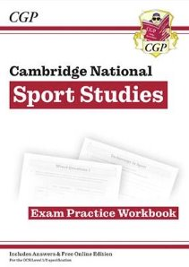
Sports studies
Wednesday 4th November
1:20pm
1hr 15 mins
Paper | Contemporary Issues in Sport | Length | 1 hour 15 minutes | Marks | 70
Topics / Subjects – what will be on the exam?
Topic Area 1: Issues Affecting Participation​ 1.1 User Groups​ 1.2 Barriers to Participation​ 1.3 Overcoming Barriers​ 1.4 Popularity of Sport​ 1.5 Emerging Sports ​ ​ Topic Area 2: Promoting Values​ 2.1 Sporting Values​ 2.2 Olympic and Paralympic Values​ 2.3 Sporting Initiatives​ 2.4 Sporting Behaviour​ 2.5 Performance Enhancing Drugs (PEDs)
Useful tips
Complete the practice questions in the white book on Topic Areas 1 and 2 using the red book to support you if needed. Answers are at the back of the white book so you can self assess your work.
Useful Revision Resources
Red CGP Revision Guide White CGP Exam Practice Workbook
Lead Teacher | Mr Collins | Email | scollins@firvale.com
Specification
https://www.ocr.org.uk/qualifications/cambridge-nationals/sport-studies-level-1-2-j829/

Slide 32
My revision timetable
Week ____ | Slot 1 _ _:_ _ -> _ _:_ _ | Slot 2 _ _:_ _ -> _ _:_ _ | Slot 3 _ _:_ _ -> _ _:_ _
Monday
Tuesday
Wednesday
Thursday
Friday
Saturday
Sunday
Week ____ | Slot 1 _ _:_ _ -> _ _:_ _ | Slot 2 _ _:_ _ -> _ _:_ _ | Slot 3 _ _:_ _ -> _ _:_ _
Monday
Tuesday
Wednesday
Thursday
Friday
Saturday
Sunday

Slide 33
My revision timetable
Week ____ | Slot 1 _ _:_ _ -> _ _:_ _ | Slot 2 _ _:_ _ -> _ _:_ _ | Slot 3 _ _:_ _ -> _ _:_ _
Monday
Tuesday
Wednesday
Thursday
Friday
Saturday
Sunday
Week ____ | Slot 1 _ _:_ _ -> _ _:_ _ | Slot 2 _ _:_ _ -> _ _:_ _ | Slot 3 _ _:_ _ -> _ _:_ _
Monday
Tuesday
Wednesday
Thursday
Friday
Saturday
Sunday

